Slide 1
REII 323– Embedded operating systems
Practical class– Introduction to HAL
Gerrit Buter
26/08/2025

Slide 2
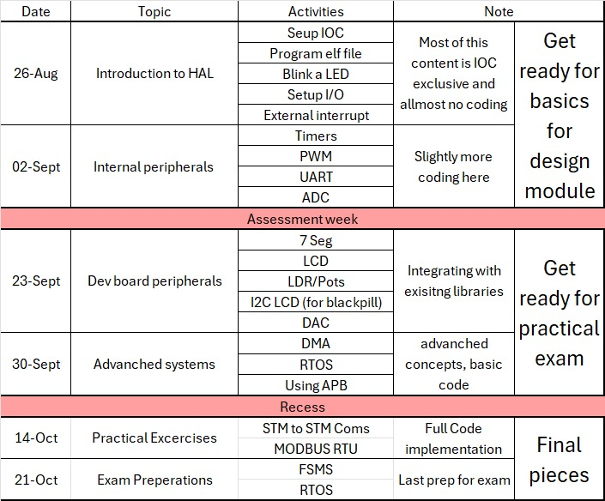
Practical program

Slide 3
Intrododuction to HAL
Outcomes
Seup IOC
Program elf file
Blink a LED
Setup I/O
External interrupt

Slide 4
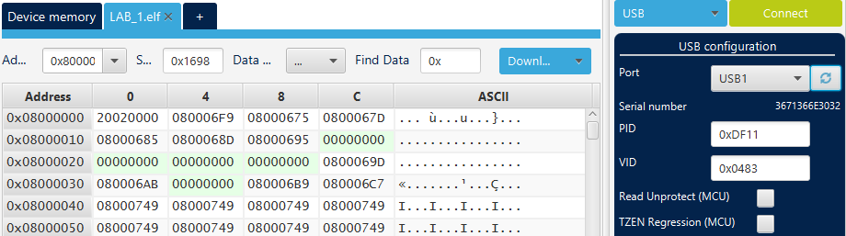
Flashing on a elf File
Use The trial Hex file to See if your programmer is working, this will also show your LCD working

Slide 5
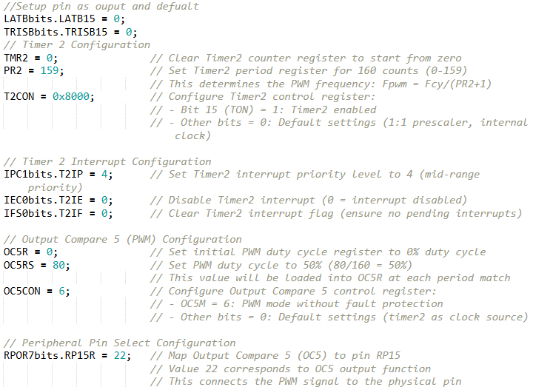
Previous knowledge: Bare metal coding

Slide 6
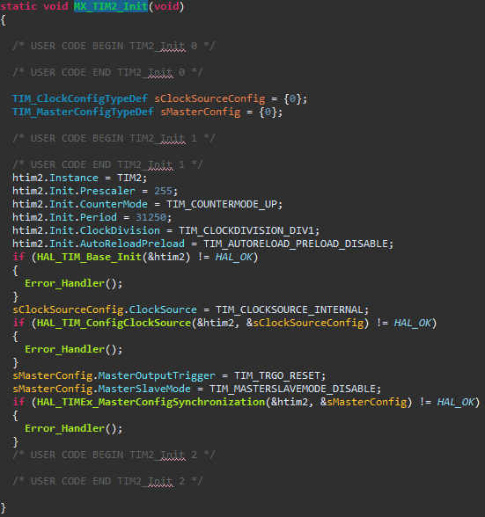
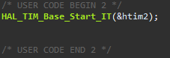
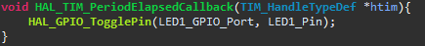
Hardware Abstract Layer (HAL)

Slide 7
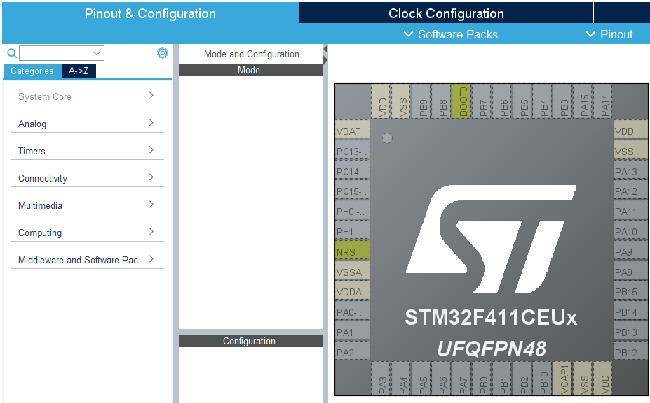
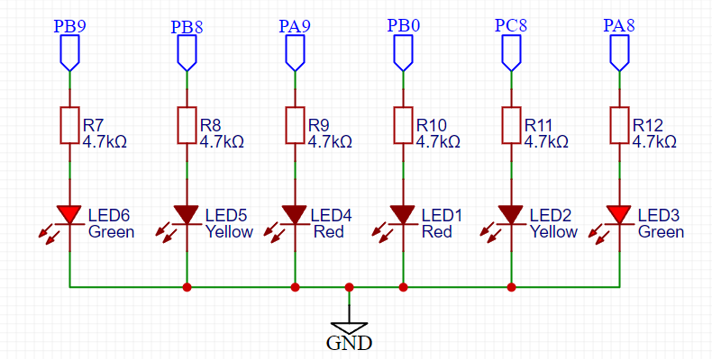
Input/Output Configuration (IOC)
Overview of the IOC, Clock config and System core
blink any one of the LEDs

Slide 8
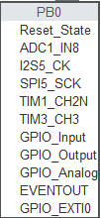
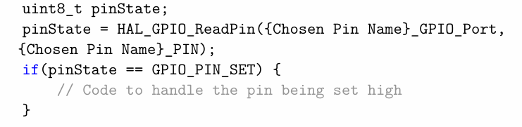
Digital I/O
Poling:
These 3 Are used for Digital I/O

Slide 9
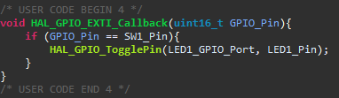

External Interrupt
NVIC:

Slide 10
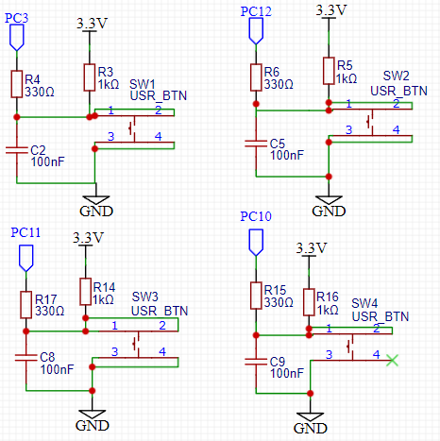
Class Activity:
Setup LED 1 to blink Every 250ms
Setup LED 2 to Mirror Switch 1
Setup LED 3 to toggle on Switch 2 Interrupt

